Slide 1

PROJECT PROPOSAL PRESENTATION
PRESENTED TO
The Developer Academy
PRESENTED BY
Cidalia Eusebio
Ethereum Price Prediction
10.03.2023

Slide 2






Agenda
Ethereum Price Prediction
3
Executive Summary
8
Ethereum Prediction
4
Proposed Solutions
5
Objectives
7
Proposed Timeline

Slide 3



Executive Summary
Ethereum Price Prediction
Cryptocurrencies investing is increasing but predict their price can be challenging due to volatility.
Can we predict with Deep learning models the Ethereum price?
Back to Agenda

Slide 4




Proposed Solutions
Ethereum Price Prediction
Back to Agenda
Solution # 1
Start with the building model build by Jose. Understand step by step time-series on next day Bitcoin price prediction. Fine tune the model for next day Ethereum price prediction.
Solution # 2
Try different deep learning models and if time, long term price prediction.

Slide 5



Ethereum Price Prediction
Objectives
TARGET/ OBJECTIVE # 1
Understand steep by step the model and fine-tune the model for Ethereum.
1 day
which variables & parameters
TARGET/ OBJECTIVE # 2
Tried different assemble deep learning models and timeframes on price predictions.
1 month, 6 months , 1 years?
Back to Agenda

Slide 6
Proposed Timeline
Ethereum Price Prediction
11-14.03
15-17.03
20-24.03
27-31.03
Briefly elaborate on what you want to discuss.
Understand the model and input for Ethereum
Fine-tune the model and input other variables.
Try different learning models and variables.
Prepare the last presentations
Back to Agenda

Slide 7

Proposed Variables
NADSAK
SP500
STOCKS
Ethereum Price prediction
BONDS- US treasuries
CPI
COMMODATIES
Gold
Metals
Energy
Silver

Slide 8
Trial & Error
Ethereum Price Prediction
1-day Ethereum
+ 30-day P
1-day + oil
1-day + cpi
Started with:
pereirajose3/bitcoin_price_prediction_ensemble_bilstm-gru_savitzky_golay_filter: Bitcoin price prediction with ensemble BiLSTM-GRU and savitzky-golay filter (github.com)
Fine-tune the model for Ethereum
Fine-tune the model and predict for 30 days
Tried adding oil as well.
Tried with CPI as well.
Back to Agenda

Slide 9
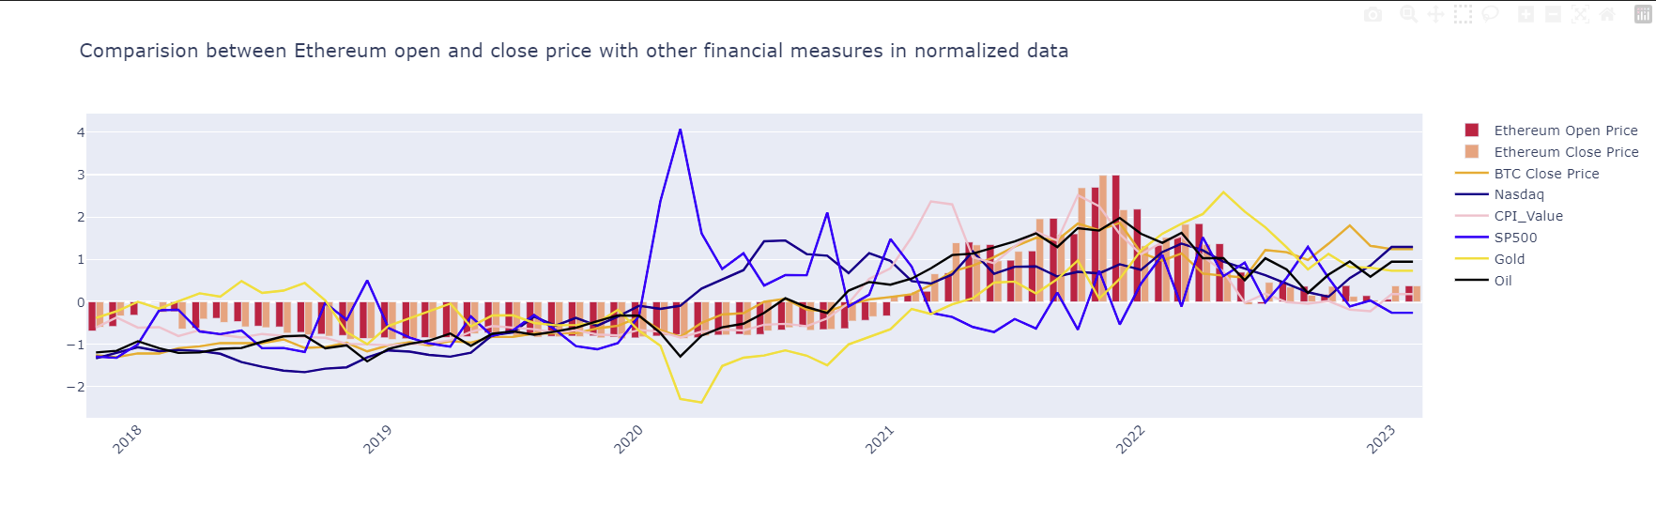
Is there any correlation?

Slide 10
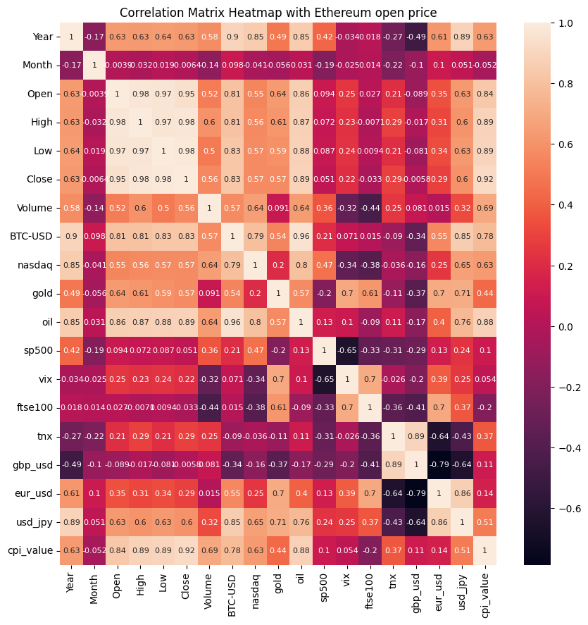
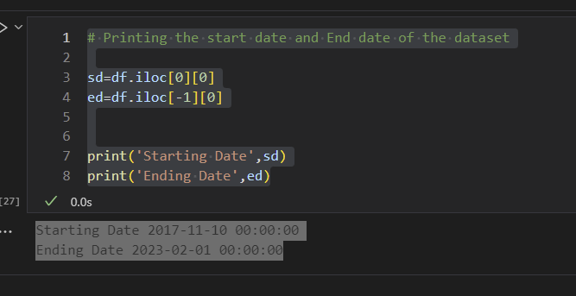
Is there any correlation?
Open 1.000000
High 0.978536
Low 0.970332
Close 0.945017
oil 0.863792
cpi_value 0.837566
BTC-USD 0.807667
gold 0.635702
Year 0.634370
usd_jpy 0.629228
nasdaq 0.552906
Volume 0.515203
eur_usd 0.348459
vix 0.251721
tnx 0.212930
sp500 0.093956
ftse100 0.027448
Month -0.003880
gbp_usd -0.088920

Slide 11
Trial & Error
Ethereum Price Prediction
1-day Ethereum
Started with:
pereirajose3/bitcoin_price_prediction_ensemble_bilstm-gru_savitzky_golay_filter: Bitcoin price prediction with ensemble BiLSTM-GRU and savitzky-golay filter (github.com)
Fine-tune the model for Ethereum
Back to Agenda

Slide 12
Trial & Error
Ethereum Price Prediction
1-day Ethereum
Import Libraries
Download data from Yahoo Finance & BLS web service
Create a data frame of the data
Explore data and fill missing values
Descriptive statistics
Data smoothing Savitzky-Golay Filter
Feature selection
Splinting the dataset into train, validation and test
Data pre-processing
Feature Scaling-normalization Min-Max
Data Representation neural networks
Baseline Performance
Deep learning model: LSTM
Train, Validation & Test
Started with:
pereirajose3/bitcoin_price_prediction_ensemble_bilstm-gru_savitzky_golay_filter: Bitcoin price prediction with ensemble BiLSTM-GRU and savitzky-golay filter (github.com)
Back to Agenda

Slide 13
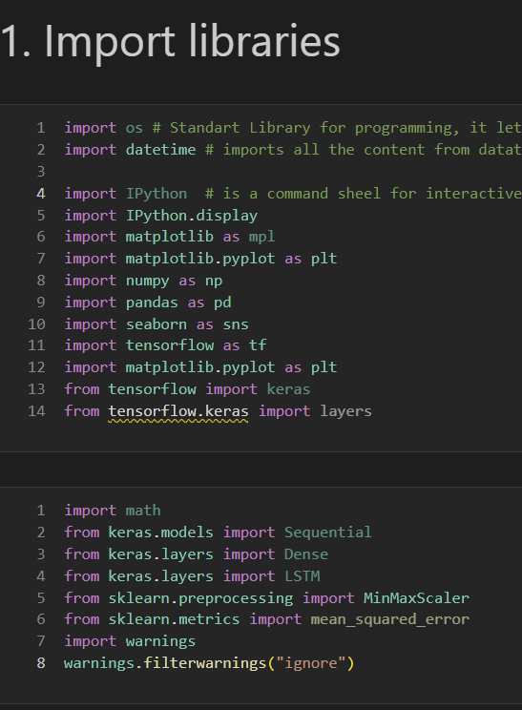
Ethereum Price Prediction
1-day Ethereum
Import Libraries
Download data from Yahoo Finance & BLS web service
Create a data frame of the data
Explore data and fill missing values
Descriptive statistics
Data smoothing Savitzky-Golay Filter
Feature selection
Splinting the dataset into train, validation and test
Data pre-processing
Feature Scaling-normalization Min-Max
Data Representation neural networks
Baseline Performance
Deep learning model: LSTM
Train, Validation & Test
Back to Agenda

Slide 14
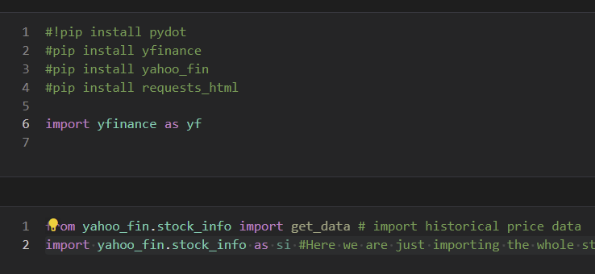
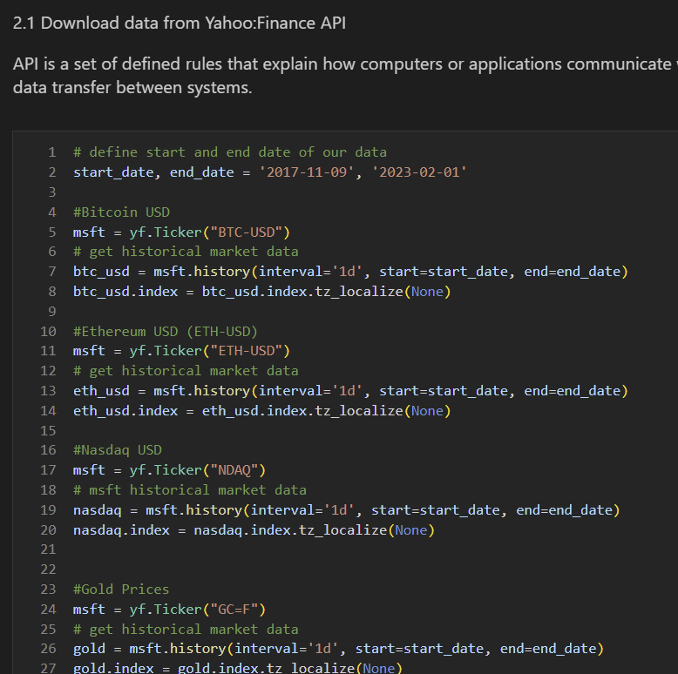
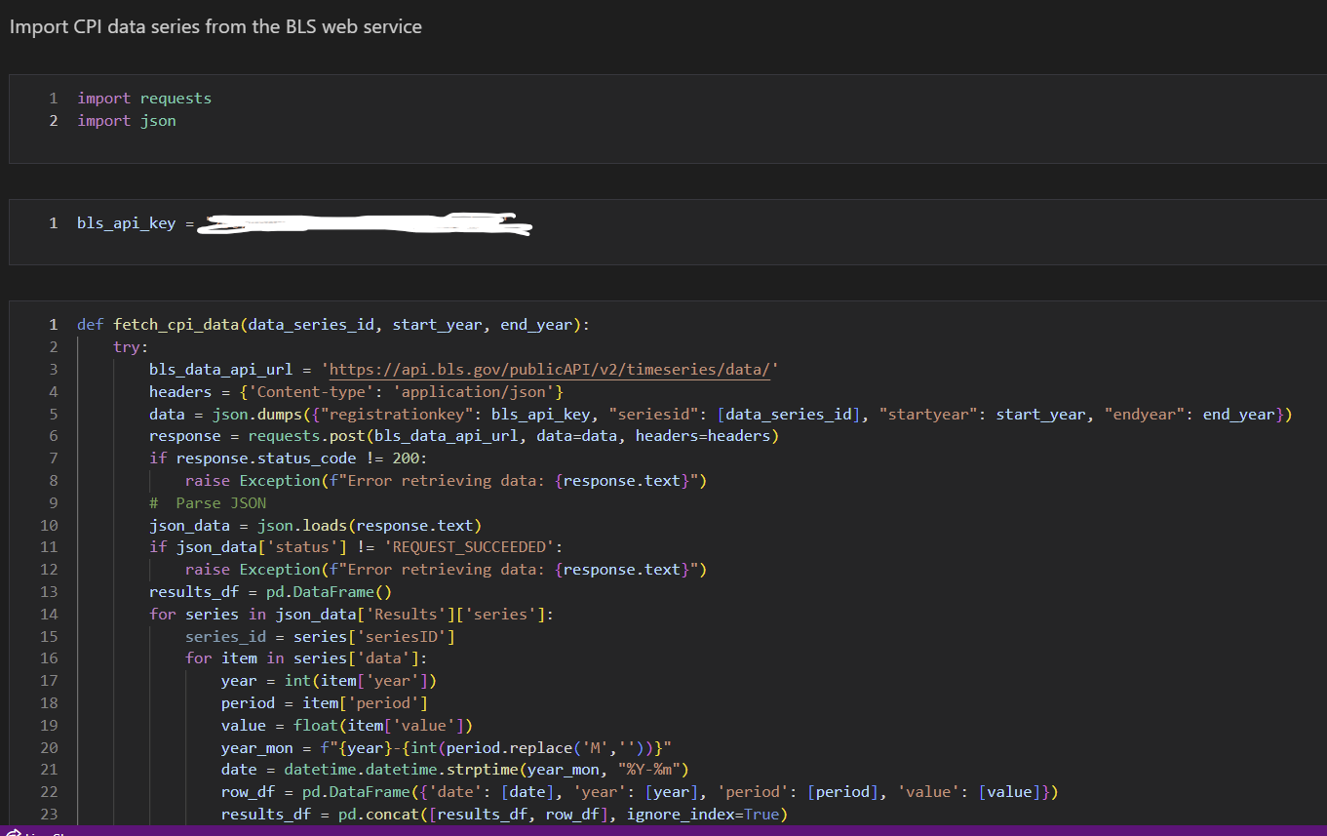
Ethereum Price Prediction
1-day Ethereum
Import Libraries
Download data from Yahoo Finance & BLS web service
Create a data frame of the data
Explore data and fill missing values
Descriptive statistics
Data smoothing Savitzky-Golay Filter
Feature selection
Splinting the dataset into train, validation and test
Data pre-processing
Feature Scaling-normalization Min-Max
Data Representation neural networks
Baseline Performance
Deep learning model: LSTM
Train, Validation & Test
Back to Agenda

Slide 15
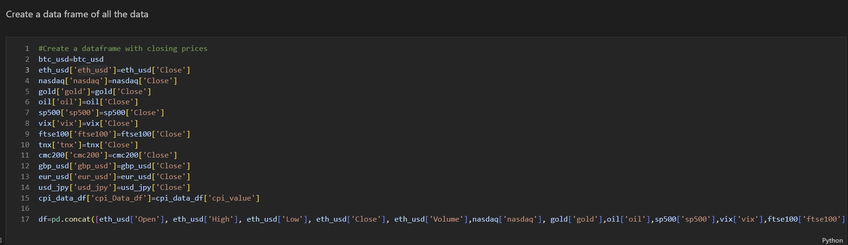
Ethereum Price Prediction
Combine data
Import Libraries
Download data from Yahoo Finance & BLS web service
Create a data frame of the data
Explore data and fill missing values
Descriptive statistics
Data smoothing Savitzky-Golay Filter
Feature selection
Splinting the dataset into train, validation and test
Data pre-processing
Feature Scaling-normalization Min-Max
Data Representation neural networks
Baseline Performance
Deep learning model: LSTM
Train, Validation & Test
Back to Agenda

Slide 16
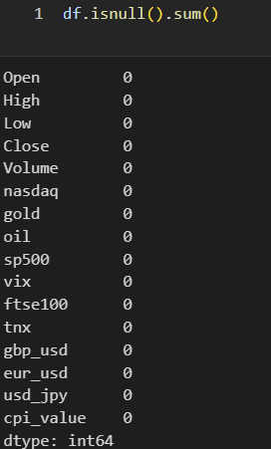
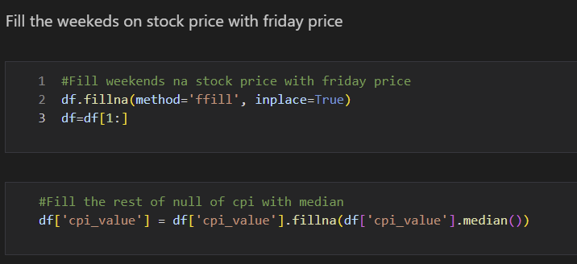
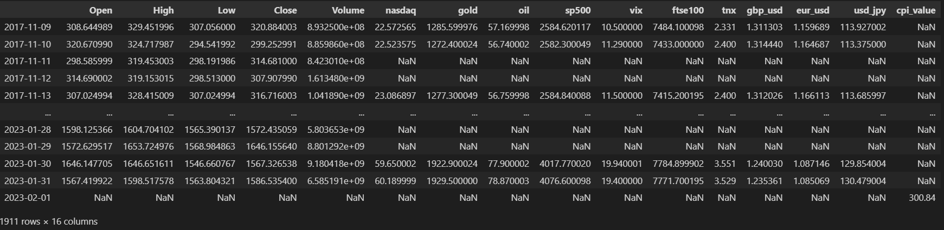
Ethereum 1 day Price Prediction
1-day Ethereum
Import Libraries
Download data from Yahoo Finance & BLS web service
Create a data frame of the data
Explore data and fill missing values
Descriptive statistics
Data smoothing Savitzky-Golay Filter
Feature selection
Splinting the dataset into train, validation and test
Data pre-processing
Feature Scaling-normalization Min-Max
Data Representation neural networks
Baseline Performance
Deep learning model: LSTM
Train, Validation & Test
Back to Agenda

Slide 17
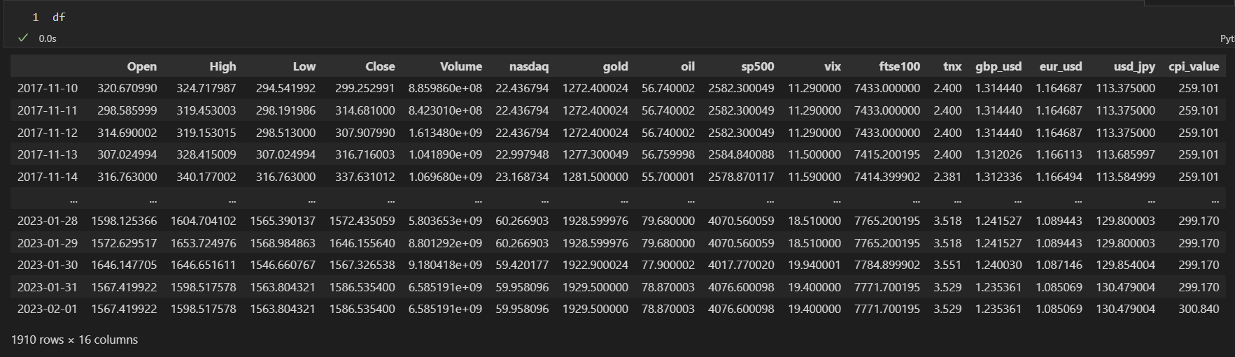
Ethereum Price Prediction
Import Libraries
Download data from Yahoo Finance & BLS web service
Create a data frame of the data
Explore data and fill missing values
Descriptive statistics
Data smoothing Savitzky-Golay Filter
Feature selection
Splinting the dataset into train, validation and test
Data pre-processing
Feature Scaling-normalization Min-Max
Data Representation neural networks
Baseline Performance
Deep learning model: LSTM
Train, Validation & Test
Back to Agenda

Slide 18
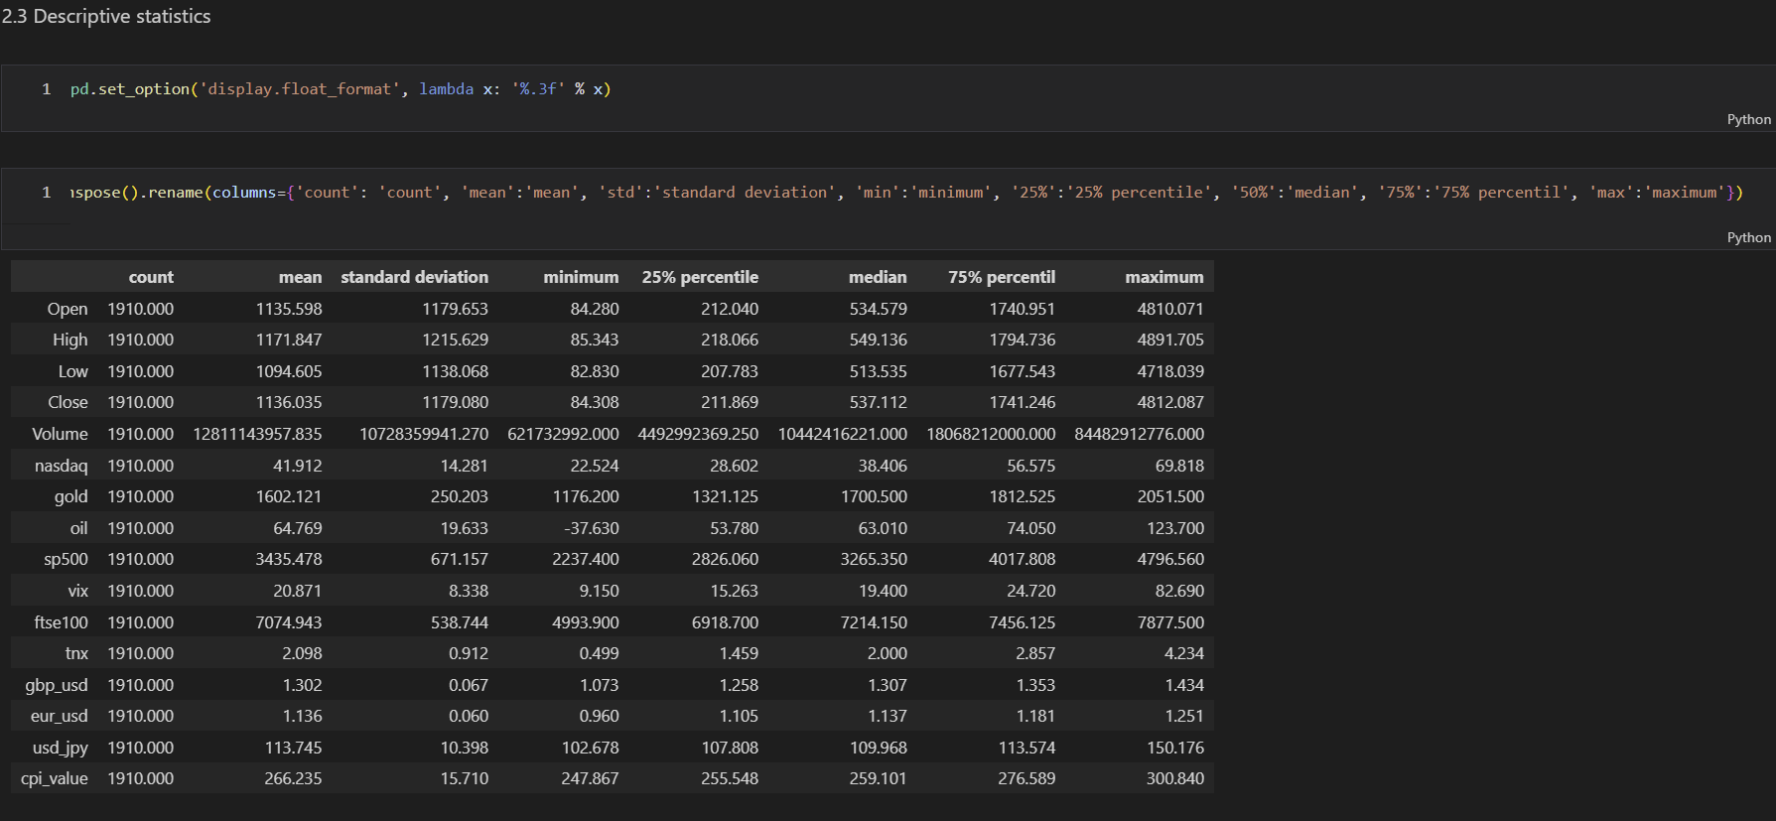
Ethereum Price Prediction
Import Libraries
Download data from Yahoo Finance & BLS web service
Create a data frame of the data
Explore data and fill missing values
Descriptive statistics
Data smoothing Savitzky-Golay Filter
Feature selection
Splinting the dataset into train, validation and test
Data pre-processing
Feature Scaling-normalization Min-Max
Data Representation neural networks
Baseline Performance
Deep learning model: LSTM
Train, Validation & Test
Back to Agenda

Slide 19
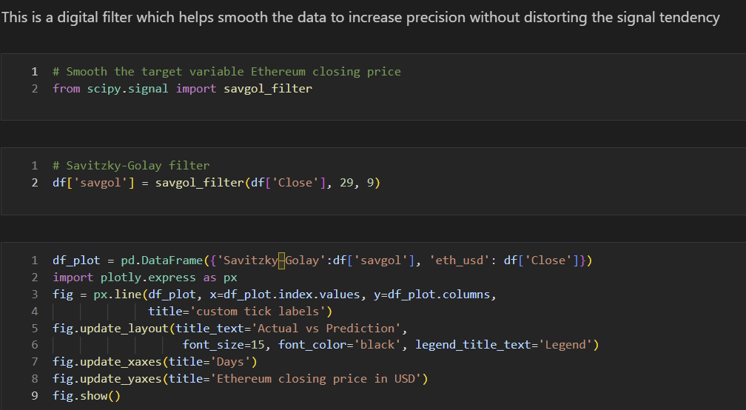
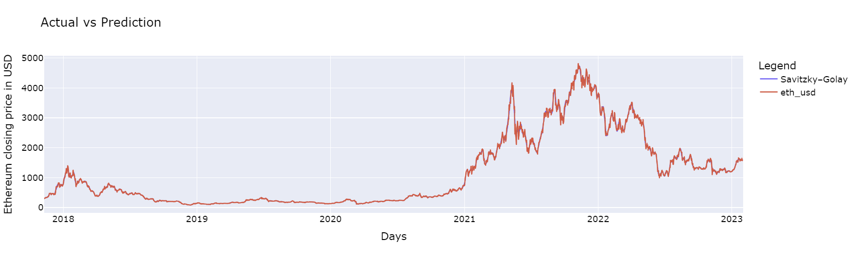
Ethereum 1 day Price Prediction
1-day Ethereum
Import Libraries
Download data from Yahoo Finance & BLS web service
Create a data frame of the data
Explore data and fill missing values
Descriptive statistics
Data smoothing Savitzky-Golay Filter
Feature selection
Splinting the dataset into train, validation and test
Data pre-processing
Feature Scaling-normalization Min-Max
Data Representation neural networks
Baseline Performance
Deep learning model: LSTM
Train, Validation & Test
Back to Agenda
Notes:
The Savitzky-Golay filter is a digital signal processing technique used for smoothing and differentiating data. It is particularly effective for noisy data that has an underlying smooth structure. The filter works by applying a local polynomial regression (usually linear or quadratic) on a sliding window of data points to estimate the smoothed value for each point.
The main idea behind the Savitzky-Golay filter is to find the best-fitting low-degree polynomial that approximates the data within a given window. The coefficients of this polynomial are then used to calculate the smoothed value for the central point in the window. This process is repeated for each point in the dataset, resulting in a smoothed version of the original data.
The Savitzky-Golay filter has several advantages over other smoothing techniques, such as moving average or Gaussian filters:
It preserves the shape and height of peaks and other features in the data, which can be important in many applications, such as spectroscopy and chromatography.
The filter can be easily adapted for different window sizes, polynomial degrees, and types of data (e.g., unevenly spaced data points).
It can be used not only for smoothing but also for differentiation and integration of data, which can be useful for analyzing data with specific trends or patterns.
However, the Savitzky-Golay filter also has some limitations, such as being sensitive to the choice of window size and polynomial degree, and not being well-suited for data with rapidly varying features or discontinuities.

Slide 20
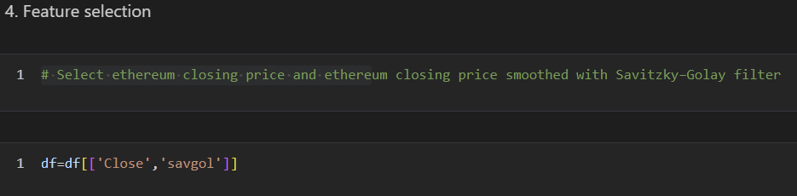
Ethereum 1 day Price Prediction
1-day Ethereum
Import Libraries
Download data from Yahoo Finance & BLS web service
Create a data frame of the data
Explore data and fill missing values
Descriptive statistics
Data smoothing Savitzky-Golay Filter
Feature selection
Splinting the dataset into train, validation and test
Data pre-processing
Feature Scaling-normalization Min-Max
Data Representation neural networks
Baseline Performance
Deep learning model: LSTM
Train, Validation & Test
Back to Agenda

Slide 21
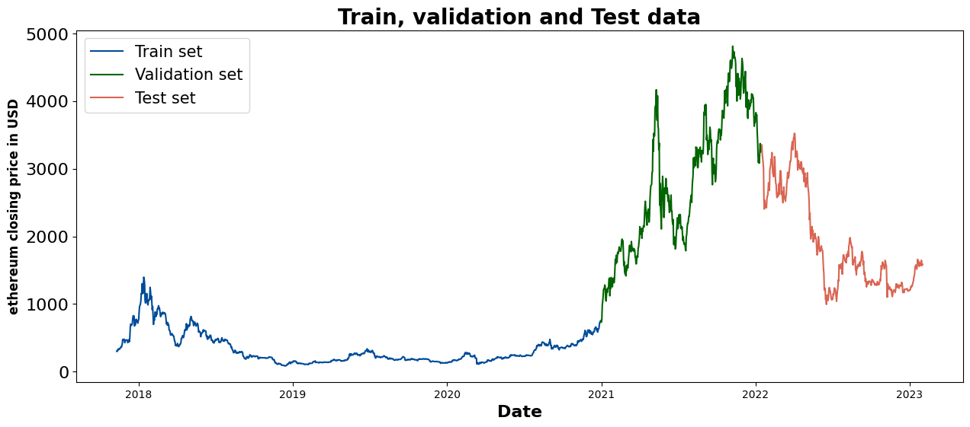
Ethereum 1 day Price Prediction
1-day Ethereum
Import Libraries
Download data from Yahoo Finance & BLS web service
Create a data frame of the data
Explore data and fill missing values
Descriptive statistics
Data smoothing Savitzky-Golay Filter
Feature selection
Splinting the dataset into train, validation and test
Data pre-processing
Feature Scaling-normalization Min-Max
Data Representation neural networks
Baseline Performance
Deep learning model: LSTM
Train, Validation & Test
Back to Agenda
Notes:
Model performance evaluation: Validation data provides an unbiased way to assess the performance of a model during training. By comparing the model's predictions on the validation dataset to the actual outcomes, you can estimate how well the model is generalizing to new, unseen data.
Avoid overfitting: Overfitting occurs when a model learns the training data too well, capturing the noise and specific details instead of the underlying patterns. As a result, it performs poorly on new, unseen data. By monitoring the model's performance on the validation data, you can detect overfitting and take corrective action, such as early stopping or adjusting the model's complexity.
Hyperparameter tuning: Machine learning models often have hyperparameters that need to be adjusted to optimize performance. Validation data helps you fine-tune these hyperparameters by providing a way to compare the performance of different configurations without using the test data, which should be reserved for the final model evaluation.
Model selection: When experimenting with different model architectures or algorithms, validation data helps you compare their performance and choose the one that performs best on the given task.
If the training, validation, and test data come from different distributions or have different characteristics, it can negatively impact the performance and generalization of your machine learning model. Here's why:
Model performance evaluation: If the validation and test data have different characteristics than the training data, it becomes difficult to assess the true performance of the model. The model may perform well on the training data but poorly on the validation and test data, leading to inaccurate conclusions about the model's generalization ability.
Overfitting risk: A model trained on a specific data distribution may overfit the training data and fail to generalize well to the validation and test data with different characteristics. This can lead to poor performance on new, unseen data.
Hyperparameter tuning: If the validation data has different characteristics than the training data, it might mislead the hyperparameter tuning process. The optimal hyperparameters for the validation data might not be optimal for the training data or the overall problem you are trying to solve.
Model selection: Differences in data distributions can lead to biased model selection, as the chosen model might work well only for the specific characteristics of the validation data and not for the broader problem.
To avoid these issues, it is crucial to ensure that the training, validation, and test data come from the same distribution and have similar characteristics. You can achieve this by:
Randomly splitting the data: Divide your dataset into training, validation, and test sets in a random manner, ensuring that each subset has a representative sample of the overall data distribution.
Stratified sampling: If your dataset has imbalanced classes or specific subgroups, use stratified sampling to maintain the same proportion of classes or subgroups in each subset.
Time-series data considerations: For time-series data, it's essential to maintain the chronological order while splitting the data. Avoid using future data for training or validation.
Regularly re-evaluate: Periodically re-evaluate your model with new data to ensure its performance remains consistent over time. Update the training, validation, and test data as needed to reflect any changes in the underlying data distribution.
By ensuring your training, validation, and test data are consistent and representative of the problem you are trying to solve, you improve the chances of your model generalizing well to new, unseen data.

Slide 22
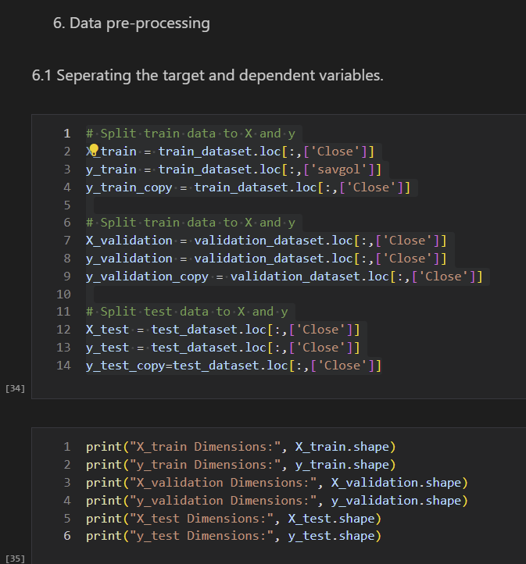
Ethereum 1 day Price Prediction
1-day Ethereum
Import Libraries
Download data from Yahoo Finance & BLS web service
Create a data frame of the data
Explore data and fill missing values
Descriptive statistics
Data smoothing Savitzky-Golay Filter
Feature selection
Splinting the dataset into train, validation and test
Data pre-processing
Feature Scaling-normalization Min-Max
Data Representation neural networks
Baseline Performance
Deep learning model: LSTM
Train, Validation & Test
Back to Agenda

Slide 23
Ethereum 1 day Price Prediction
1-day Ethereum
Import Libraries
Download data from Yahoo Finance & BLS web service
Create a data frame of the data
Explore data and fill missing values
Descriptive statistics
Data smoothing Savitzky-Golay Filter
Feature selection
Splinting the dataset into train, validation and test
Data pre-processing
Feature Scaling-normalization Min-Max
Data Representation neural networks
Baseline Performance
Deep learning model: LSTM
Train, Validation & Test
Back to Agenda

Slide 24
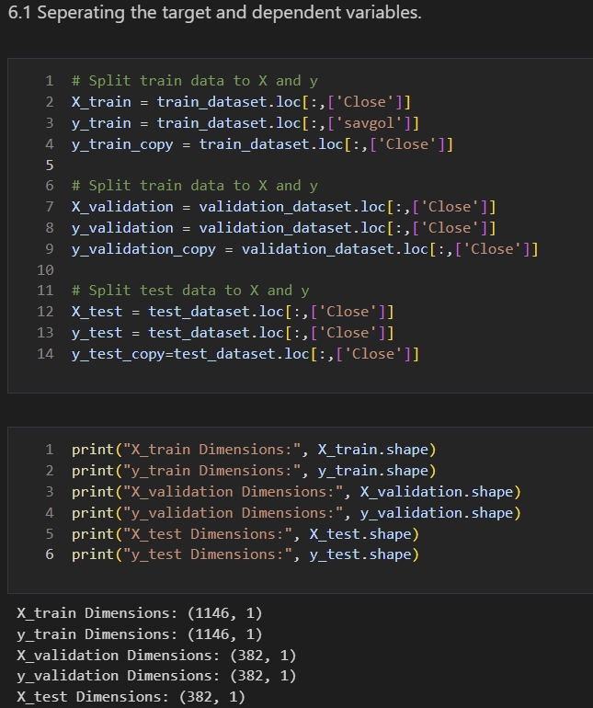
Ethereum 1 day Price Prediction
1-day Ethereum
Import Libraries
Download data from Yahoo Finance & BLS web service
Create a data frame of the data
Explore data and fill missing values
Descriptive statistics
Data smoothing Savitzky-Golay Filter
Feature selection
Splinting the dataset into train, validation and test
Data pre-processing
Feature Scaling-normalization Min-Max
Data Representation neural networks
Baseline Performance
Deep learning model: LSTM
Train, Validation & Test
Back to Agenda

Slide 25
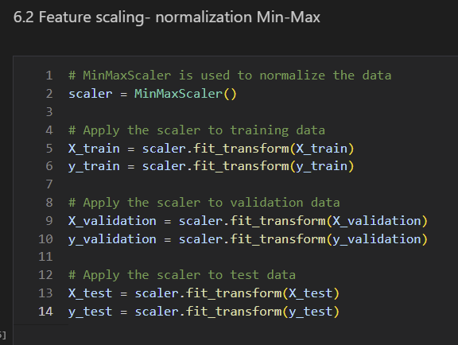
Ethereum 1 day Price Prediction
1-day Ethereum
Import Libraries
Download data from Yahoo Finance & BLS web service
Create a data frame of the data
Explore data and fill missing values
Descriptive statistics
Data smoothing Savitzky-Golay Filter
Feature selection
Splinting the dataset into train, validation and test
Data pre-processing
Feature Scaling-normalization Min-Max
Data Representation neural networks
Baseline Performance
Deep learning model: LSTM
Train, Validation & Test
Back to Agenda

Slide 26
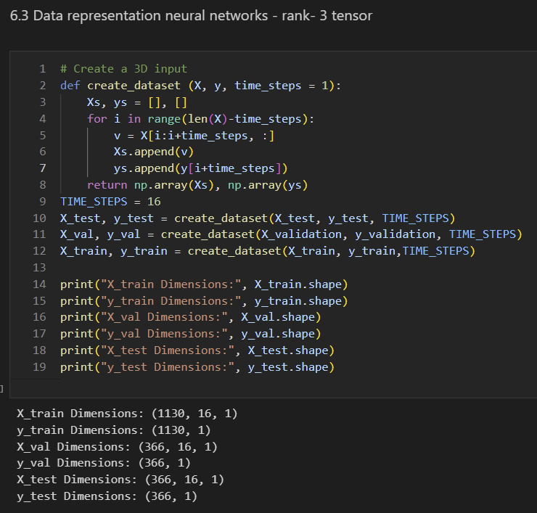
Ethereum 1 day Price Prediction
1-day Ethereum
Import Libraries
Download data from Yahoo Finance & BLS web service
Create a data frame of the data
Explore data and fill missing values
Descriptive statistics
Data smoothing Savitzky-Golay Filter
Feature selection
Splinting the dataset into train, validation and test
Data pre-processing
Feature Scaling-normalization Min-Max
Data Representation neural networks
Baseline Performance
Deep learning model: LSTM
Train, Validation & Test
Back to Agenda

Slide 27
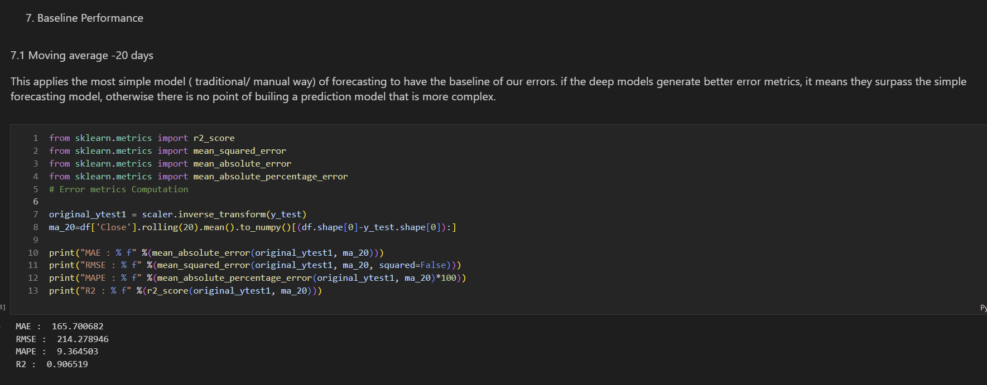
Ethereum 1 day Price Prediction
1-day Ethereum
Import Libraries
Download data from Yahoo Finance & BLS web service
Create a data frame of the data
Explore data and fill missing values
Descriptive statistics
Data smoothing Savitzky-Golay Filter
Feature selection
Splinting the dataset into train, validation and test
Data pre-processing
Feature Scaling-normalization Min-Max
Data Representation neural networks
Baseline Performance
Deep learning model: LSTM
Train, Validation & Test
Back to Agenda

Slide 28
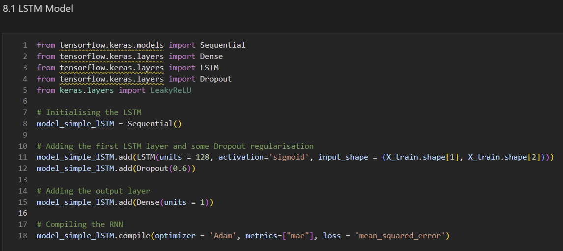
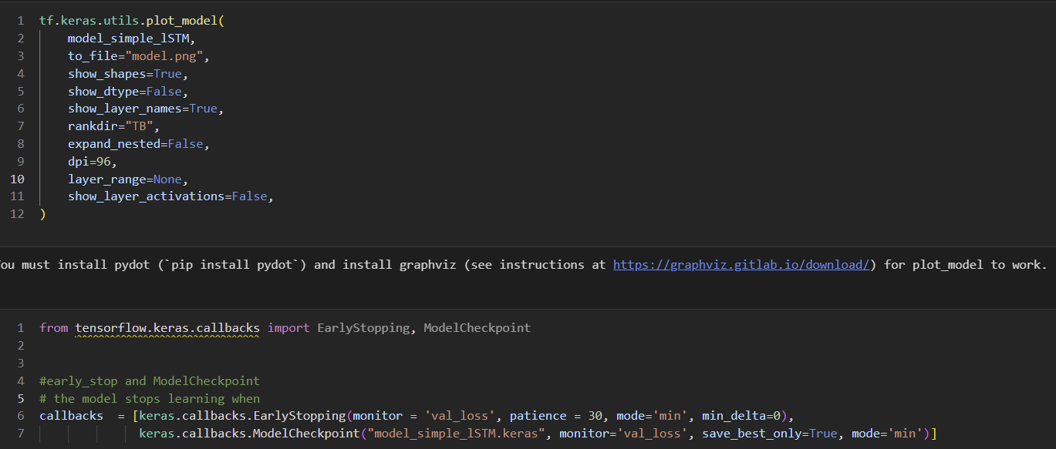
Ethereum 1 day Price Prediction
1-day Ethereum
Import Libraries
Download data from Yahoo Finance & BLS web service
Create a data frame of the data
Explore data and fill missing values
Descriptive statistics
Data smoothing Savitzky-Golay Filter
Feature selection
Splinting the dataset into train, validation and test
Data pre-processing
Feature Scaling-normalization Min-Max
Data Representation neural networks
Baseline Performance
Deep learning model: LSTM
Train, Validation & Test
Back to Agenda

Slide 29
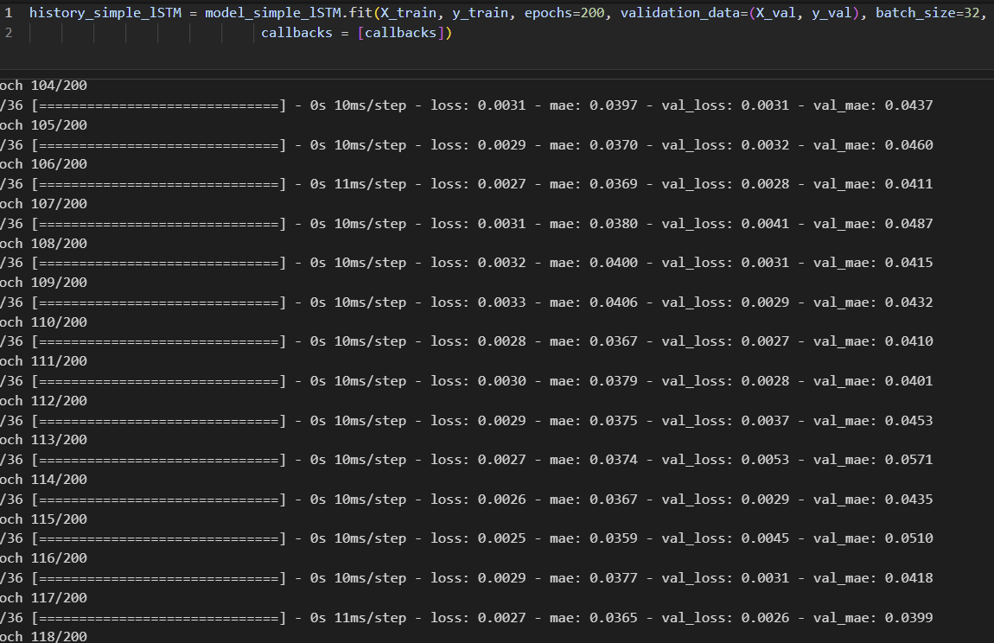
Ethereum 1 day Price Prediction
1-day Ethereum
Import Libraries
Download data from Yahoo Finance & BLS web service
Create a data frame of the data
Explore data and fill missing values
Descriptive statistics
Data smoothing Savitzky-Golay Filter
Feature selection
Splinting the dataset into train, validation and test
Data pre-processing
Feature Scaling-normalization Min-Max
Data Representation neural networks
Baseline Performance
Deep learning model: LSTM
Train, Validation & Test
Back to Agenda

Slide 30
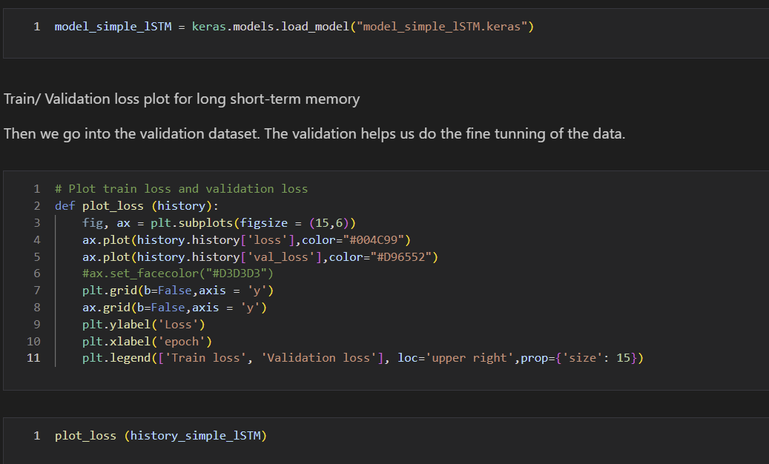
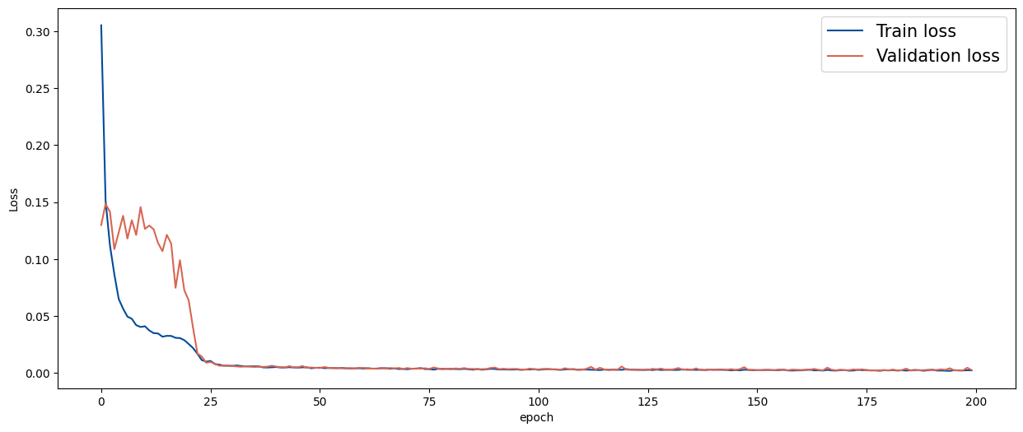
Ethereum 1 day Price Prediction
1-day Ethereum
Import Libraries
Download data from Yahoo Finance & BLS web service
Create a data frame of the data
Explore data and fill missing values
Descriptive statistics
Data smoothing Savitzky-Golay Filter
Feature selection
Splinting the dataset into train, validation and test
Data pre-processing
Feature Scaling-normalization Min-Max
Data Representation neural networks
Baseline Performance
Deep learning model: LSTM
Train, Validation & Test
Back to Agenda

Slide 31
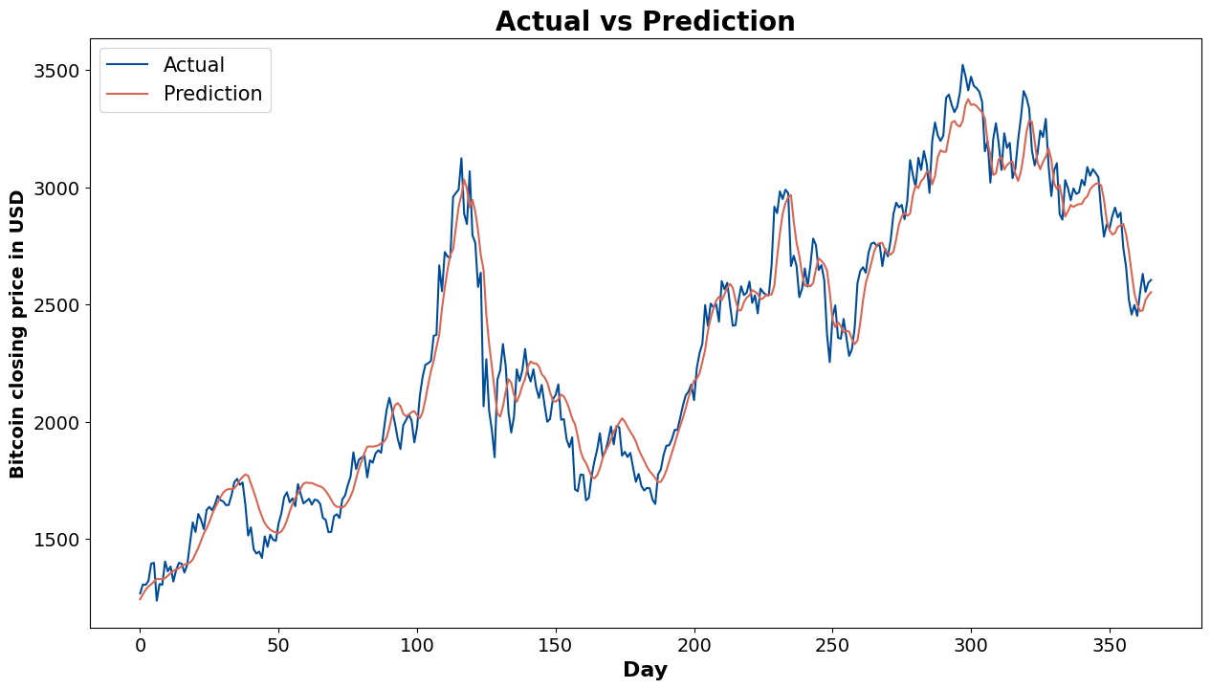
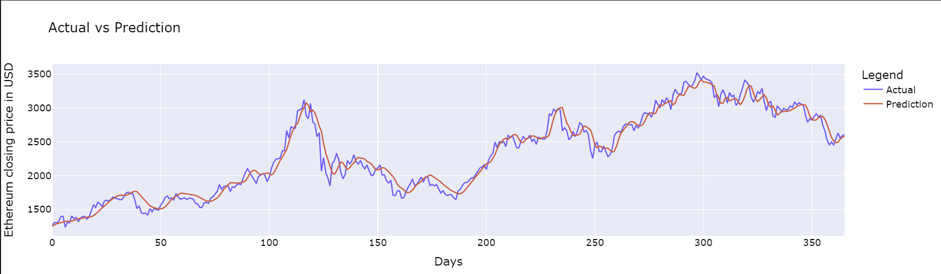
Ethereum 1 day Price Prediction: validation
1-day Ethereum
Import Libraries
Download data from Yahoo Finance & BLS web service
Create a data frame of the data
Explore data and fill missing values
Descriptive statistics
Data smoothing Savitzky-Golay Filter
Feature selection
Splinting the dataset into train, validation and test
Data pre-processing
Feature Scaling-normalization Min-Max
Data Representation neural networks
Baseline Performance
Deep learning model: LSTM
Train, Validation & Test
MAE : 88.503893
RMSE : 115.361871
MAPE : 4.026521
R2 : 0.963248
Back to Agenda
Notes:
A lower MAE indicates a better model performance. In your case, the MAE is 88.503893, which means that, on average, the model's predictions are approximately 88.5 units away from the true values.
Your model has an RMSE of 115.361871, which implies that, on average, the model's predictions are approximately 115.4 units away from the true values.
Your model has a MAPE of 4.026521, which means that, on average, the model's predictions are about 4.03% off from the true values.
R2 of 0.963248, which suggests that it explains approximately 96.32% of the variance in the data, indicating a strong performance.

Slide 32
Trial & Error
Ethereum Price Prediction
1-day Ethereum-CPI
Started with:
pereirajose3/bitcoin_price_prediction_ensemble_bilstm-gru_savitzky_golay_filter: Bitcoin price prediction with ensemble BiLSTM-GRU and savitzky-golay filter (github.com)
Fine-tune the model for Ethereum with CPI
Back to Agenda

Slide 33

Ethereum 1 day Price Prediction: validation
Import Libraries
Download data from Yahoo Finance & BLS web service
Create a data frame of the data
Explore data and fill missing values
Descriptive statistics
Data smoothing Savitzky-Golay Filter
Feature selection
Splinting the dataset into train, validation and test
Data pre-processing
Feature Scaling-normalization Min-Max
Data Representation neural networks
Baseline Performance
Deep learning model: LSTM
Train, Validation & Test
MAE : 96
RMSE : 133
MAPE : 5
R2:0.96
Back to Agenda
Notes:
A lower MAE indicates a better model performance. In your case, the MAE is 88.503893, which means that, on average, the model's predictions are approximately 88.5 units away from the true values.
Your model has an RMSE of 115.361871, which implies that, on average, the model's predictions are approximately 115.4 units away from the true values.
Your model has a MAPE of 4.026521, which means that, on average, the model's predictions are about 4.03% off from the true values.
R2 of 0.963248, which suggests that it explains approximately 96.32% of the variance in the data, indicating a strong performance.

Slide 34
Trial & Error
Ethereum Price Prediction
1-day Ethereum-Oil
Started with:
pereirajose3/bitcoin_price_prediction_ensemble_bilstm-gru_savitzky_golay_filter: Bitcoin price prediction with ensemble BiLSTM-GRU and savitzky-golay filter (github.com)
Fine-tune the model for Ethereum with Oil
Back to Agenda

Slide 35
Ethereum 1 day Price Prediction + OIL: validation
Import Libraries
Download data from Yahoo Finance & BLS web service
Create a data frame of the data
Explore data and fill missing values
Descriptive statistics
Data smoothing Savitzky-Golay Filter
Feature selection
Splinting the dataset into train, validation and test
Data pre-processing
Feature Scaling-normalization Min-Max
Data Representation neural networks
Baseline Performance
Deep learning model: LSTM
Train, Validation & Test
MAE :93
RMSE: 123
MAPE: 4.16
R2:95%
Back to Agenda
Notes:
A lower MAE indicates a better model performance. In your case, the MAE is 88.503893, which means that, on average, the model's predictions are approximately 93 units away from the true values.
on average, the model's predictions are approximately 123 units away from the true values.
on average, the model's predictions are about 4.16% off from the true values.
R2 of 0.963248, which suggests that it explains approximately 95% of the variance in the data, indicating a strong performance.

Slide 36
Trial & Error
Ethereum Price Prediction
+ 30-day Ethereum
Price Prediction
1-day Ethereum-Oil
Started with:
pereirajose3/bitcoin_price_prediction_ensemble_bilstm-gru_savitzky_golay_filter: Bitcoin price prediction with ensemble BiLSTM-GRU and savitzky-golay filter (github.com)
Fine-tune the model for Ethereum for 30 days
Back to Agenda

Slide 37
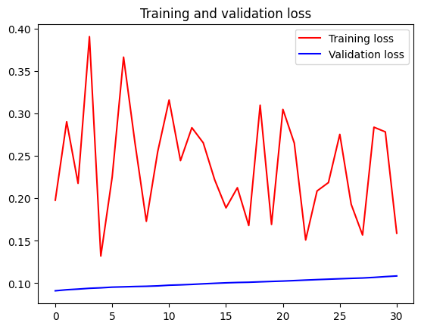
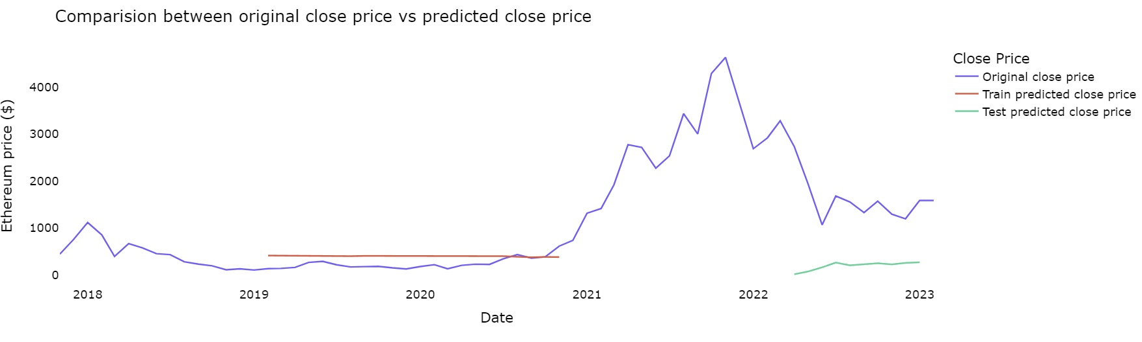
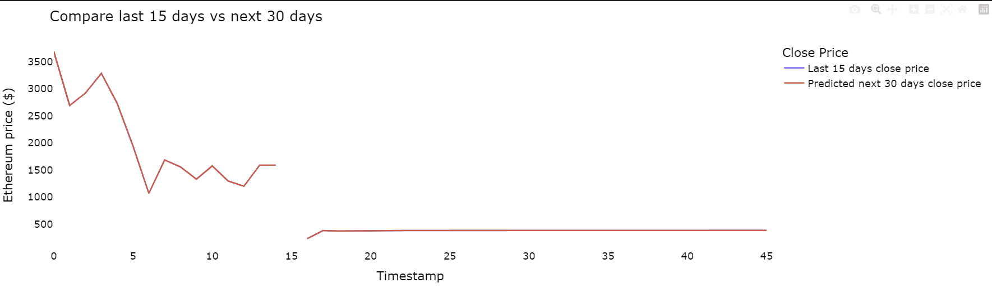
Ethereum 30 day Price Prediction: validation
MAE : 1399
RMSE : 1490
r2: -10.321089
Import Libraries
Download data from Yahoo Finance & BLS web service
Create a data frame of the data
Explore data and fill missing values
Descriptive statistics
Data smoothing Savitzky-Golay Filter
Feature selection
Splinting the dataset into train, validation and test
Data pre-processing
Feature Scaling-normalization Min-Max
Data Representation neural networks
Baseline Performance
Deep learning model: LSTM
Train, Validation & Test
Back to Agenda
Notes:
The R2 scores you provided indicate that your model is not performing well on either the training or the test dataset. The R2 score (coefficient of determination) is a statistical measure that represents the proportion of the variance in the dependent variable that can be predicted from the independent variables. An R2 score of 1 indicates a perfect fit, while an R2 score of 0 suggests that the model does not explain any of the variance in the target variable. Negative R2 scores imply that the model is performing worse than a simple average of the target variable.
Given the poor performance of your model, you may want to consider some of the following steps to improve it:
Revisit the data preprocessing steps to ensure that your data is properly cleaned, normalized, or standardized.
Examine the model architecture and try different configurations (e.g., additional layers, different activation functions, or varying the number of neurons).
Experiment with other types of models (e.g., different neural network architectures, or even non-neural models like regression trees or support vector machines).
Perform feature engineering to create new features or eliminate irrelevant ones, which may help the model better capture the underlying patterns in the data.
Check for data leakage, which can occur when information from the target variable is unintentionally included in the input features, leading to overfitting and poor generalization.
Adjust hyperparameters such as the learning rate, batch size, or the number of training epochs.

Slide 38
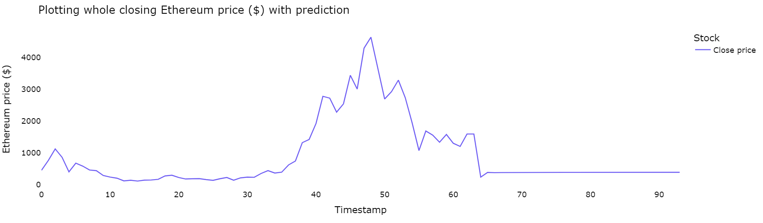
Ethereum 30 day Price Prediction: validation
Back to Agenda
Notes:
A lower MAE indicates a better model performance. In your case, the MAE is 88.503893, which means that, on average, the model's predictions are approximately 88.5 units away from the true values.
Your model has an RMSE of 115.361871, which implies that, on average, the model's predictions are approximately 115.4 units away from the true values.
Your model has a MAPE of 4.026521, which means that, on average, the model's predictions are about 4.03% off from the true values.
R2 of 0.963248, which suggests that it explains approximately 96.32% of the variance in the data, indicating a strong performance.

Slide 39
Conclusion
Ethereum Price Prediction
Back to Agenda
Time series is a difficult model to apply to predict further days # 1
Solution # 2
Try different deep learning models and if time, long term price prediction.
Drag and drop your photo or video! Click the sample photo or video and delete.
Select yours from the uploads tab, drag, and then drop inside the frame!

Slide 40


Thank you.
Ethereum price prediction

